Slide 1
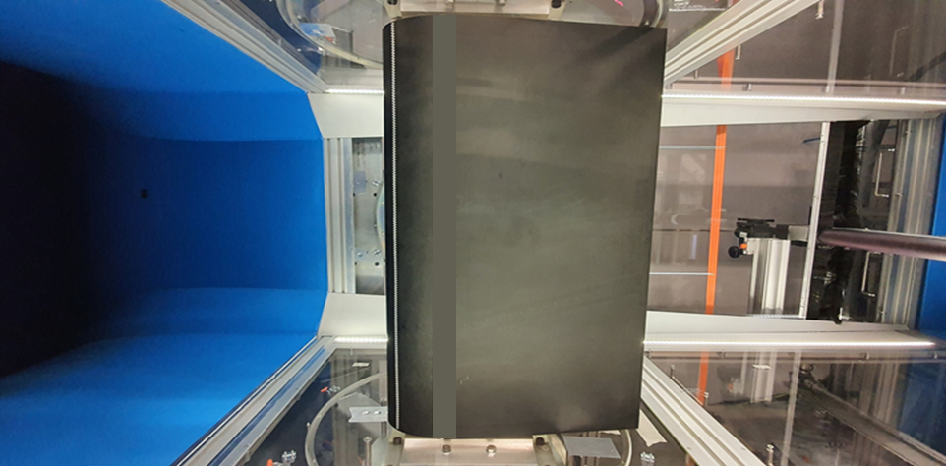
Let’s be blunt and drop the mic
An experimental study of very thick flatback airfoils

Slide 2
Results
Outputs
New proposed use for Passive Vortex Generators on wind turbine airfoils
Performance increase of the Flatback Airfoil profile by means of a Gurney Flap
Aeroacoustic measurements on a 20% thick blunt trailing edge airfoil for the first time
Journal Papers
Manolesos, M., & Papadakis, G. (2021). Investigation of the three-dimensional flow past a flatback wind turbine airfoil at high angles of attack. Physics of Fluids, 33(8), 085106.
Cene, A., Grasso, F., Manolesos M. (2022) Thick airfoils, Vortex Generators, Gurney Flaps and Flatback Solutions: How to get better performance out of the blade inner region? To be submitted to Wind Energy Science Journal, Q4 2021
Conference Presentations
Cene, A., Grasso, F., Manolesos M. (2021) Aerodynamic and Aeroacoustic Measurements of the Flow Past a Very Thick Flatback Airfoil with Passive Flow Control Devices, 2022 AIAA SciTech Forum, Accepted
Cene, A., Grasso, F., Manolesos M. (2021) An experimental investigation of the flow past a very thick flatback airfoil suitable for wind turbine blades, UK Fluids Conference, 8-10 September 2021, Southampton, UK
Manolesos, M. & Papadakis, G. (2021) Bluff Body Shedding and Stall Cells: Numerical Simulation of a Flatback Airfoil at High Angles of Attack, Wind Energy Science Conference - EAWE, May 2021, Hannover, Germany
Cene, A., Grasso, F., Manolesos M. (2021) Thick airfoils, Vortex Generators, Gurney Flaps and Flatback Solutions: How to get better performance out of the blade inner region? Wind Energy Science Conference - EAWE, May 2021, Hannover, Germany

